Slide 1

DWB
8/10 – 8/24

Slide 2
Updates
Console | Resize | Deformation
Border debugging | Inspect resize functions | Deformation on Canvas
Console formatting | Inspect handlers | Untraceable

Slide 3
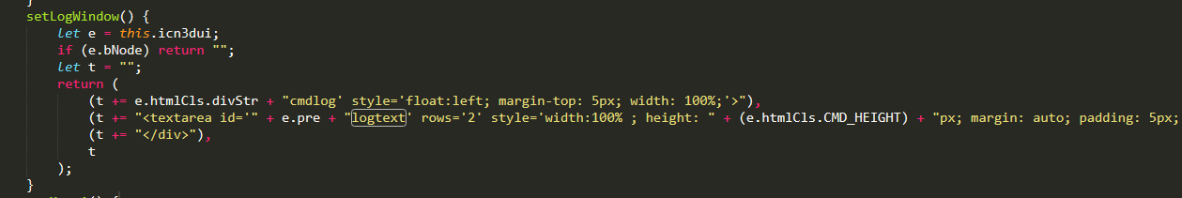

Console: Borders
Notes:
Last time we left off at adding borders to console but when we do. The width and height of the page changes so that scrollbars appear and the console border extends outside of the intended space.

Slide 4

Console: Borders
Notes:
Tried:
Offsetting by the border size
Setting right side padding
Redefining the margins
Defining the border using after and before
Solution:
Box-sizing: border-box;

Slide 5
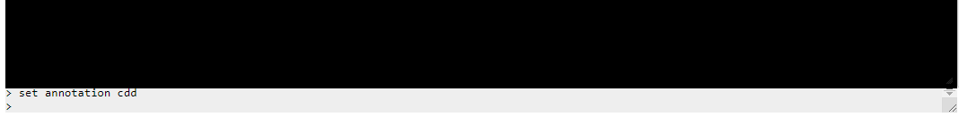
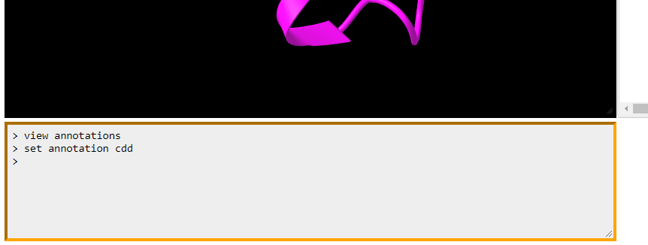
Console: Reformat
Notes:
Before and after comparison of console: border and formatting (margins + padding)

Slide 6
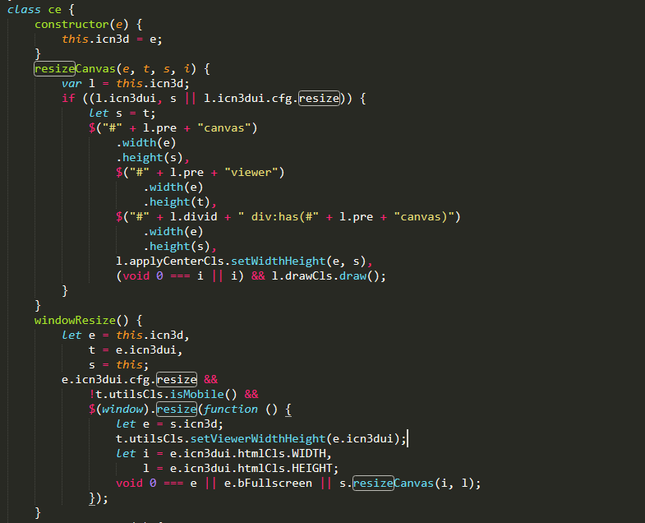
Resize: Functions
Notes:
In the JavaScript file, under class ce, there are two functions that deal with the canvas resizing structure.

Slide 7
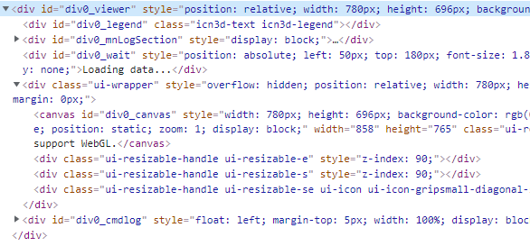
Resize: Functions
Notes:
When tracing the first function, the parameters e, t, s, seem to be integers as they define the width and height of certain html elements. Looking at height and width, t and s may be equivalent.

Slide 8
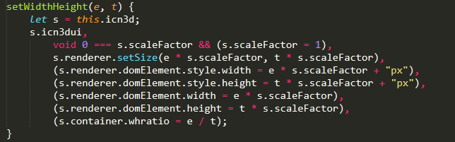
Resize: Functions
Notes:
Tracing one of the functions within resizeCanvas. Scale factor does not seem to change.

Slide 9
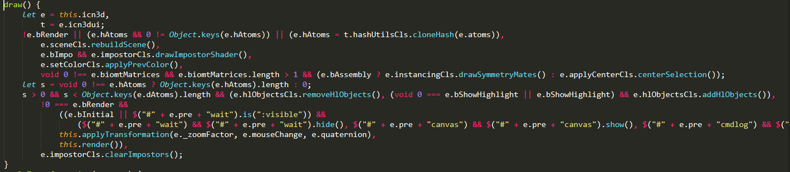
Resize: Functions
Notes:
Tracing the draw() function within resizeCanvas -> applyTransformation -> render

Slide 10
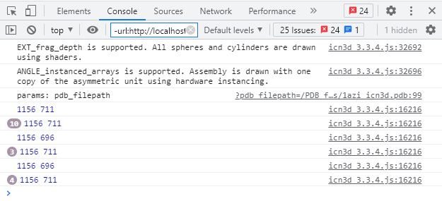
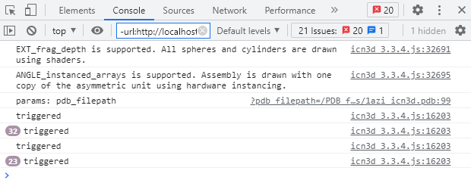
Resize: Functions
Notes:
Logged the function resizeCanvas(), windowResize()

Slide 11
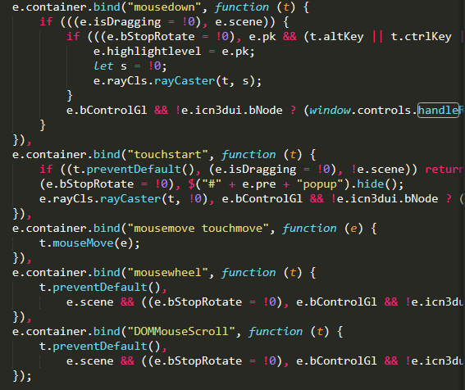
Resize: Functions
Notes:
Traced all mouse events and functions:
mouseDown only triggered within canvas not handlers
first ternary condition does not log
nested if does not log

Slide 12
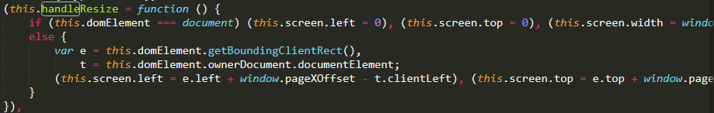
Resize: Functions
Notes:
Trace handleResize() function

Slide 13
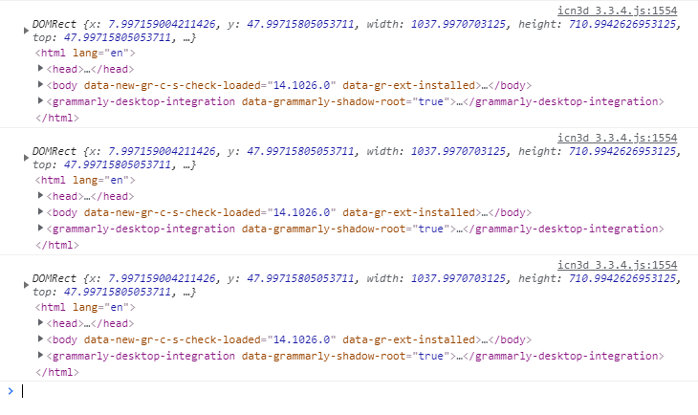
Resize: Functions
Notes:
Trace handleResize() function:
e: DOMRect obj
t: html
this: THREE.TrackballControls

Slide 14
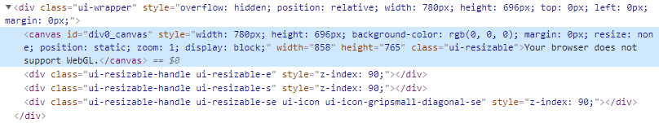
Resize: Functions
Notes:
Trace ui-resizable-handles

Slide 15
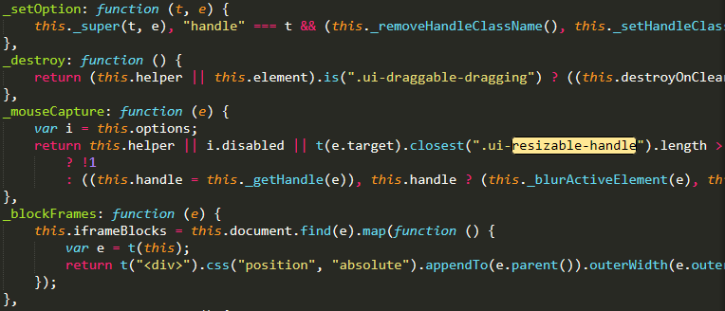
Resize: Functions
Notes:
Under jquery-ui unminified:
_mouseCapture function: cannot trigger on handles on canvas but does on seq & anno

Slide 16
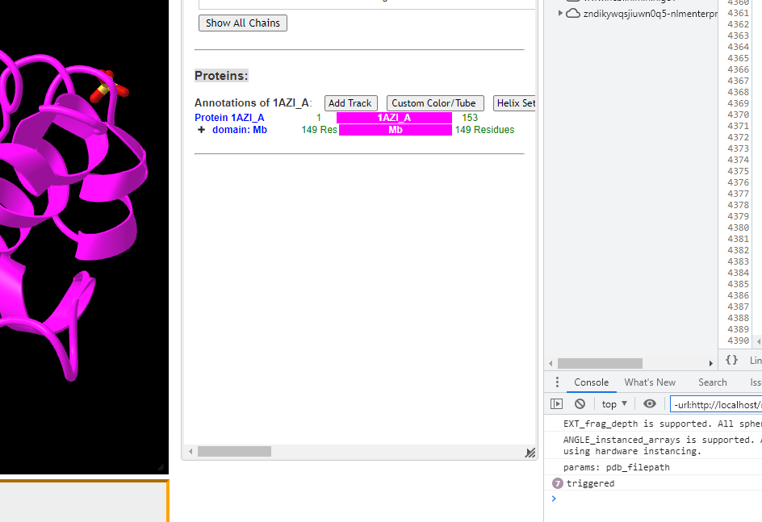
Resize: Functions
Notes:
Clicking the resize handlers on seq & anno triggers logging, but not on actual canvas.

Slide 17
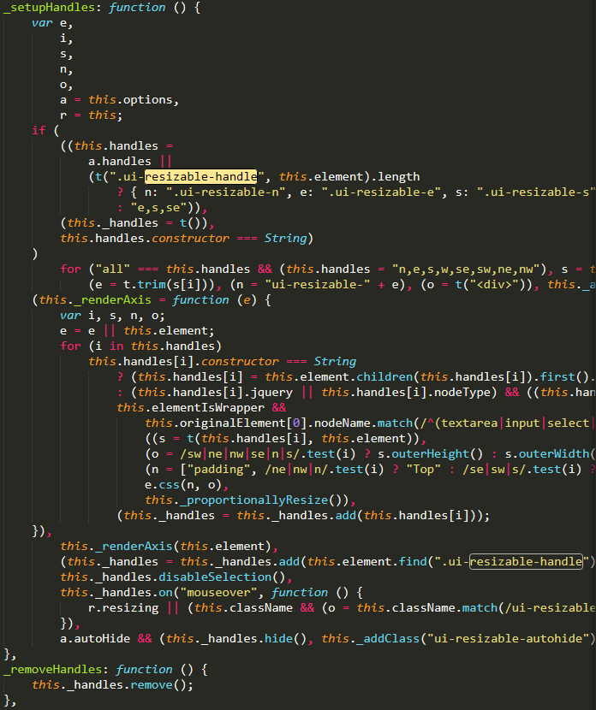
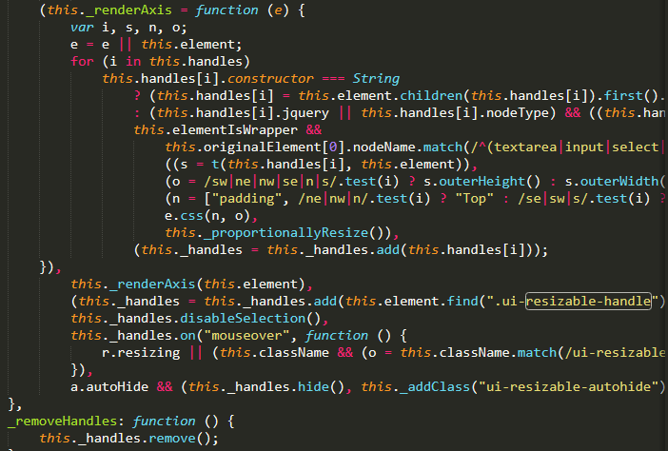
Resize: Functions
Notes:
Under _setupHandles mouse events are defined.

Slide 18
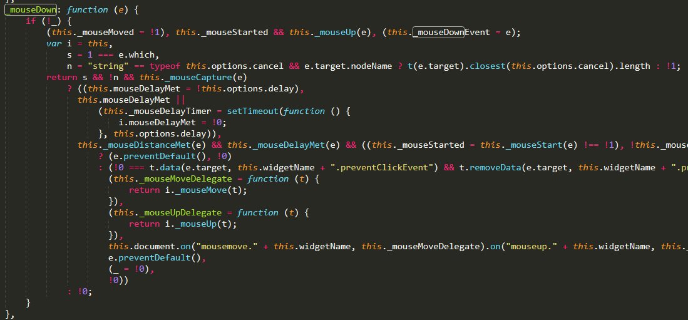
Resize: Functions
Notes:
Tracing mouseDown

Slide 19
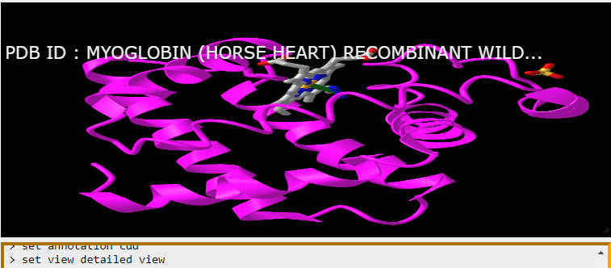
Deformation: Canvas
Notes:
Re-exploring the deformation caused by resizing when another window is shown.

Slide 20
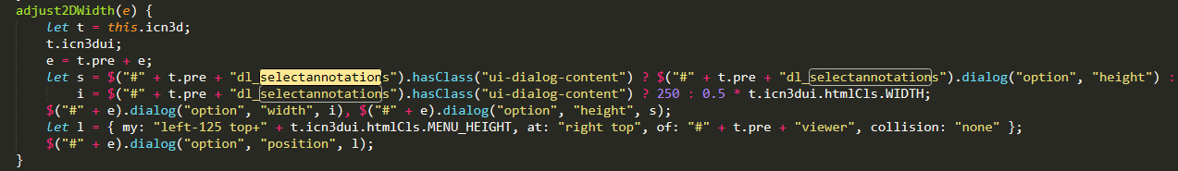
Deformation: Canvas
Notes:
Tracing function adjust2DWidth(e):
positions the window of seq and anno

Slide 21
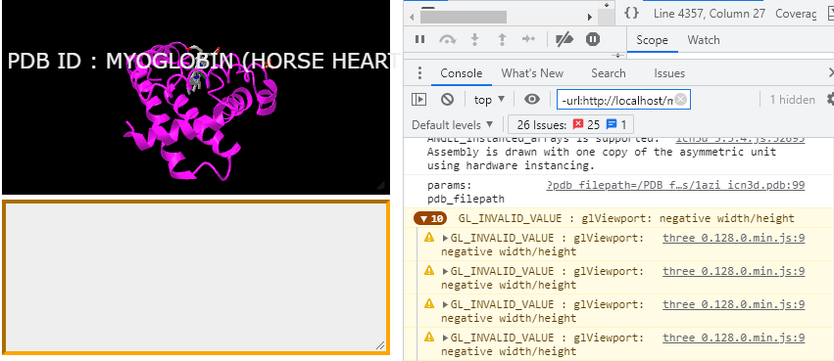
Deformation: Canvas
Notes:
Negative width and height traceback from glViewport (three.js)

